Slide 1
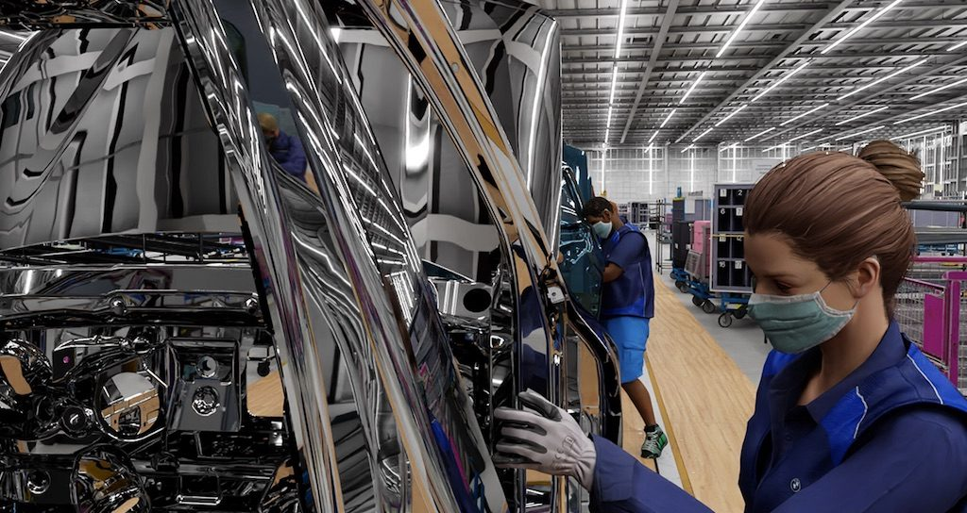
Synthetic Data Generation
for Machine Learning
Savelyev A.S. M107-22

Slide 2



Abstract
Oh no...
We have no enough data...
Just generate it,
Bruh...

Slide 3
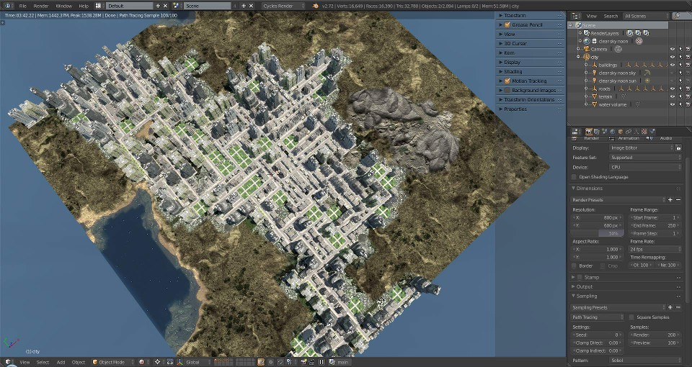
What is synthetic data
3D-Scene created
using City Generator

Slide 4
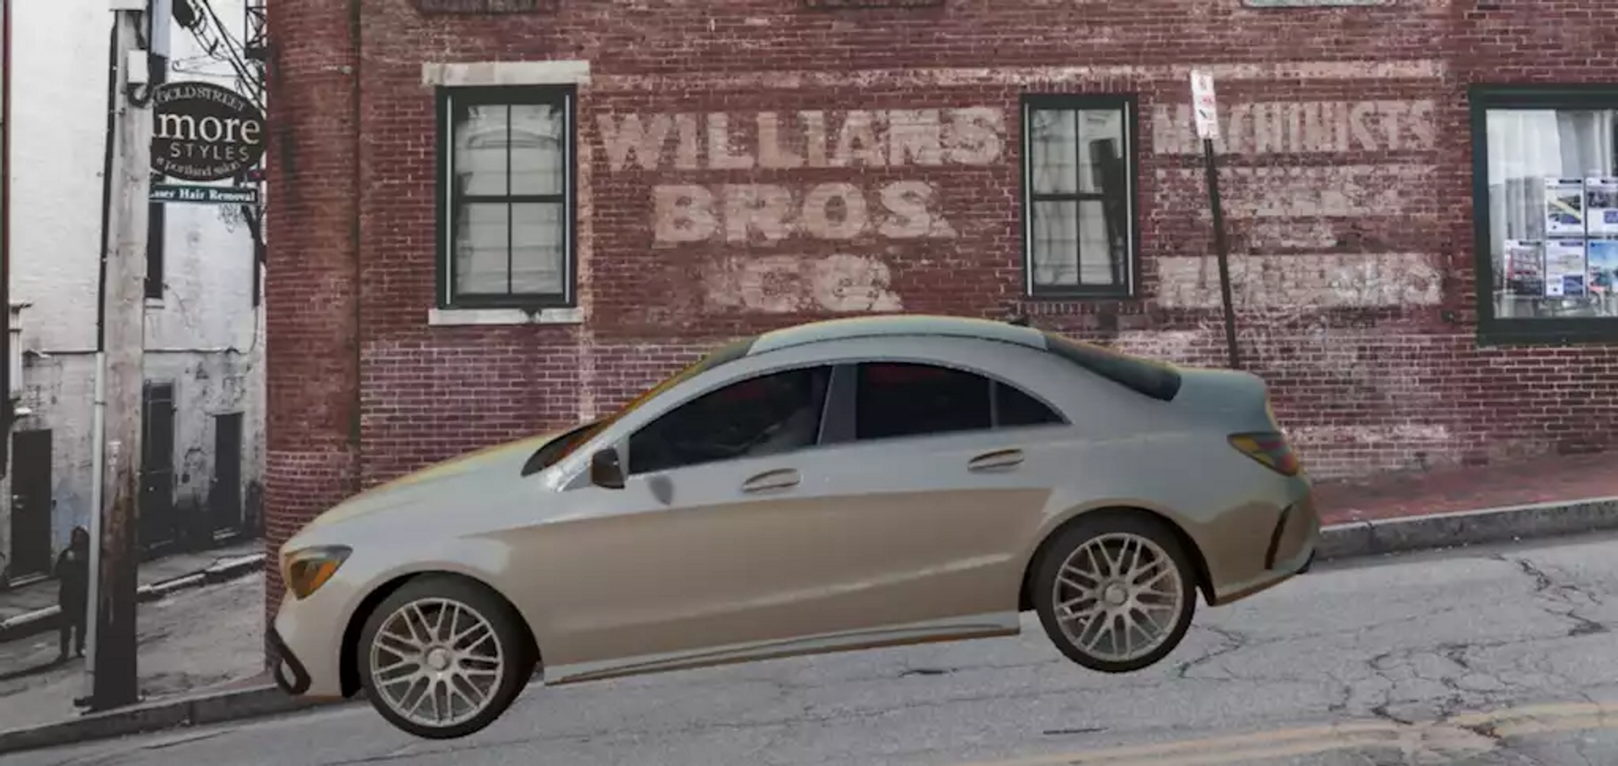
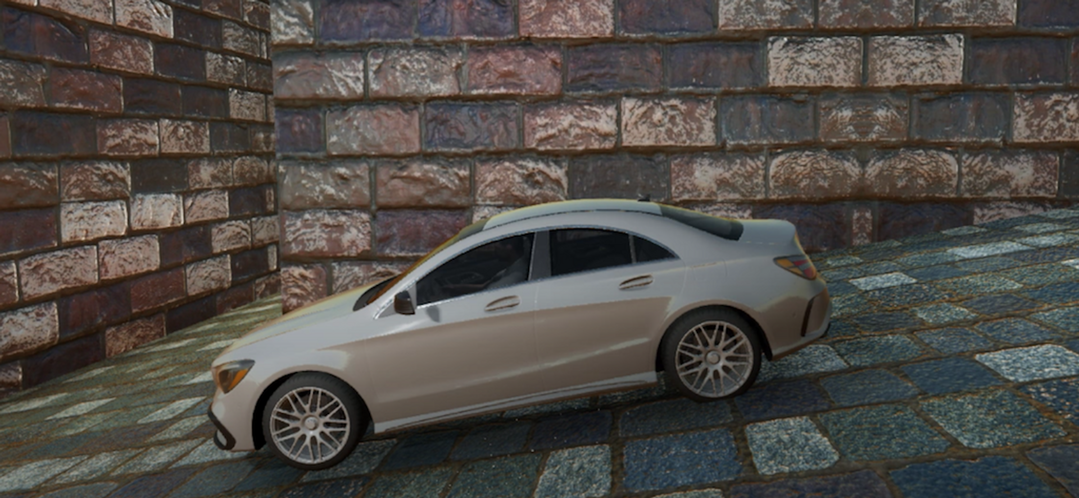
Types of
synthetic data
- Partial Type
Background is real,
car is not
- Full type
Background and car
is not real

Slide 5
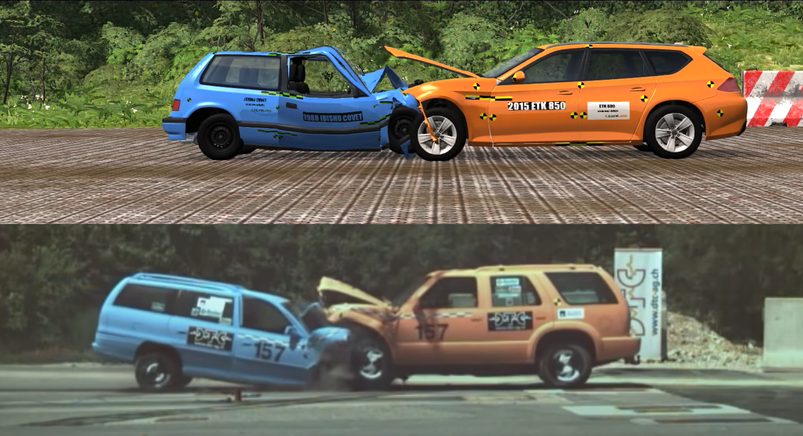
When and why synthetic data is used?

Slide 6


Tabular synthetic data
Im a person and
my data is pesonal!
No problem, we use
tabular data generator

Slide 7


Text synthetic data
This Chatbot
is so cool
We trained him
on synthetic text data

Slide 8
Synthetic data is cool

Slide 9
Thanks for your attention

